Slide 1

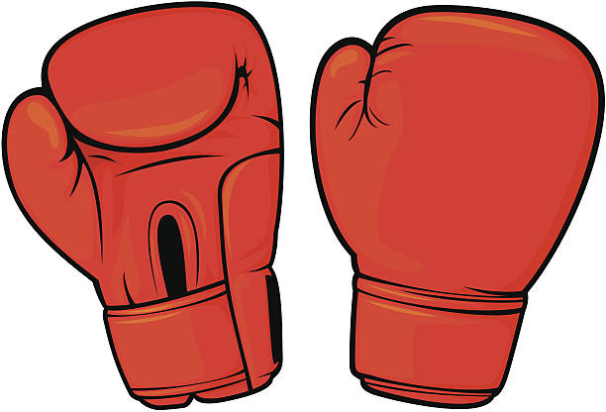
Which sport should our company put our effort towards?
MMA or BOXING?
Jinda (Jesse) Phan

Slide 2
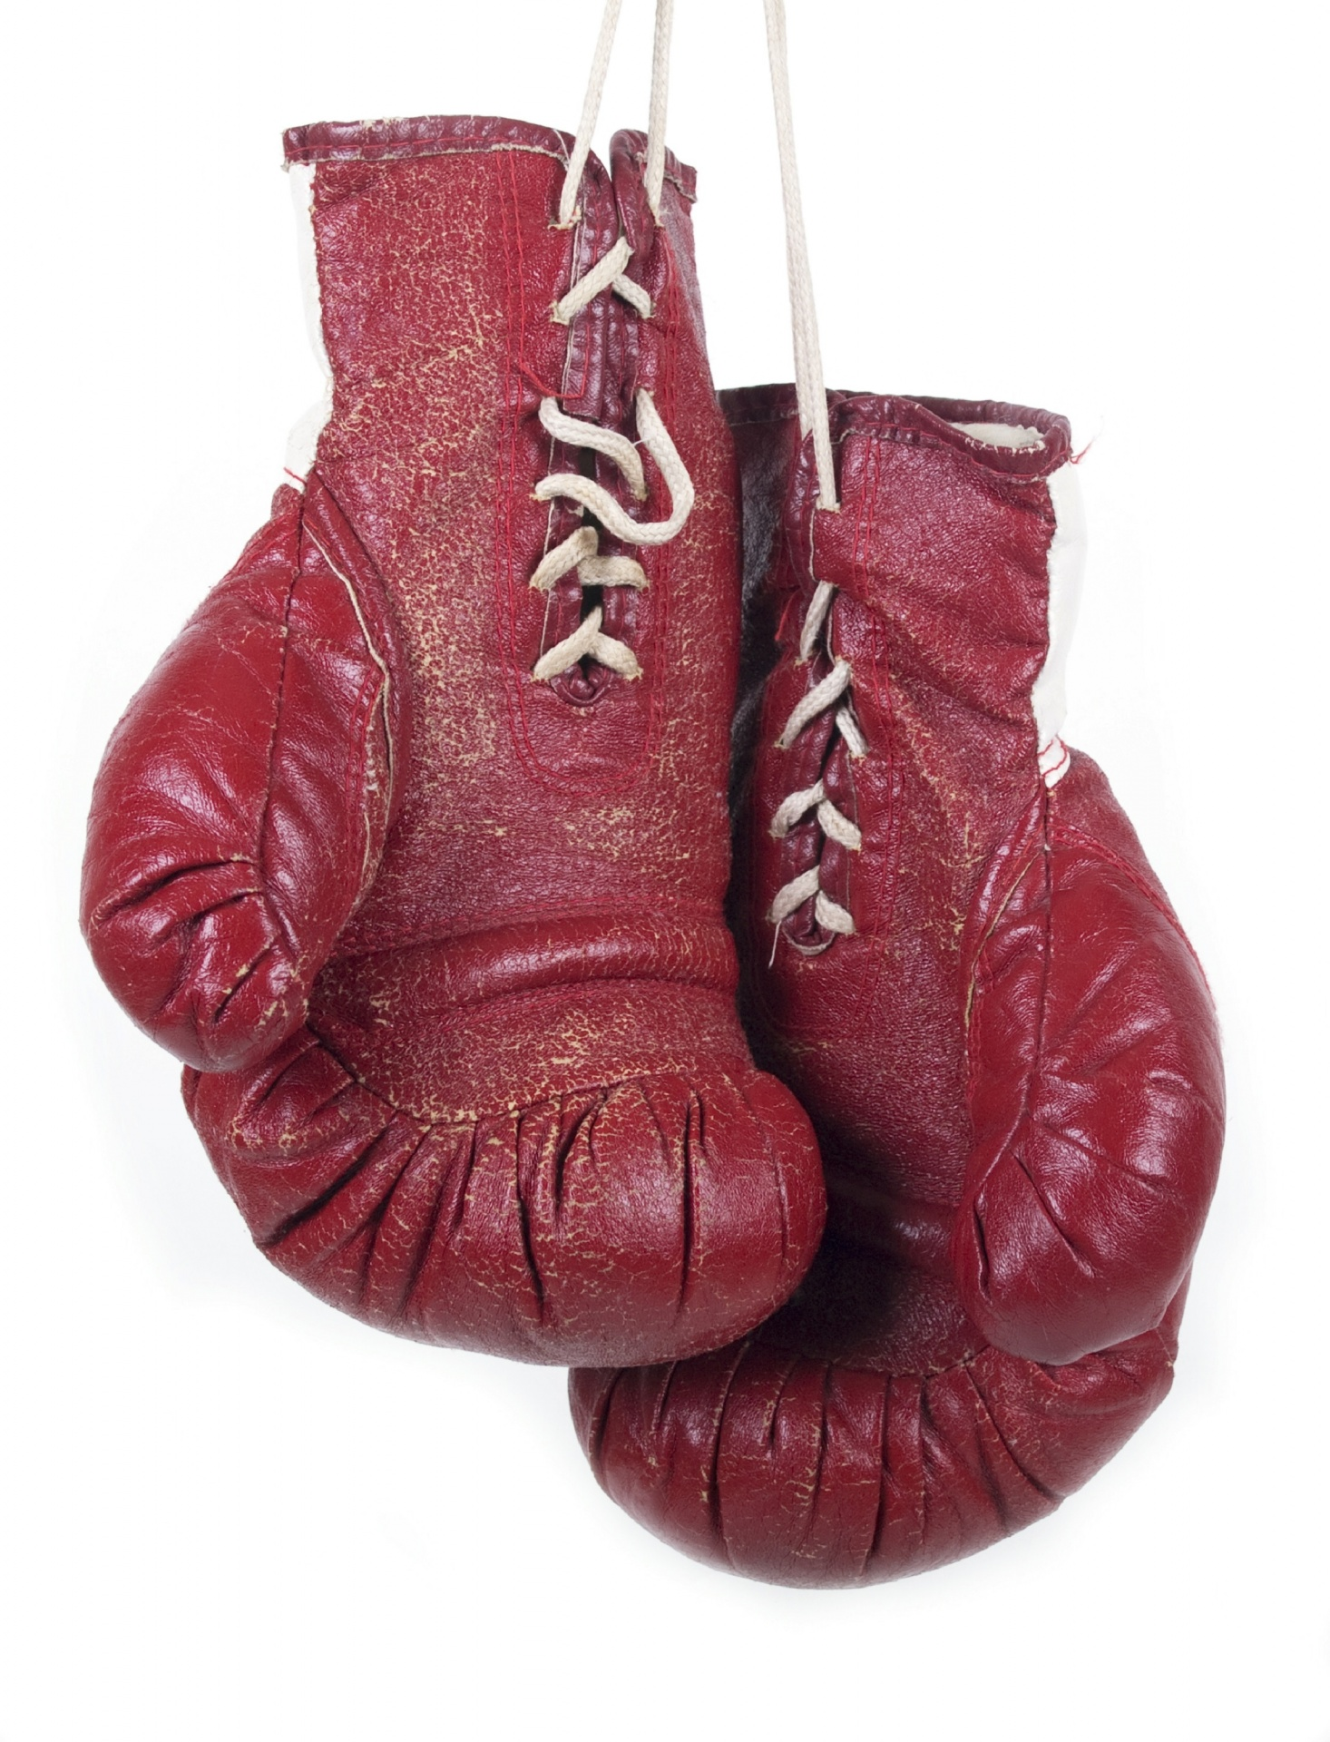
Why?
Want to get into a combat sport and get into a niche.
Other sports are too competitive with media companies, and going this pathway we can get exclusive media rights
Able to earn more money into the company and gain public support

Slide 3



Tools
Python:
Able to create the graphs and scrape the data using the same source
Create visually appealing graphs easily using Matplotlib and Pandas data frames
Excel:
Use spreadsheets to store data for use in other scripts
PowerPoint
Visualise the data, and share information easily

Slide 4
Process
The survey data has already been prepared by UMass Lowell. I used Python to retrieve the Wikipedia data (data was from reputable sources and/or estimations from media companies). To clean the data, I removed the annotations, formatted the date and names, and made sure that values that are not applicable do not show up in the result.
Biases have been removed by the survey being anonymous, objective (search and PPV numbers) and credible (cited from reputable sources, and trusted voices in the world i.e. UMass Lowell). The data is as reliable as any other public source, as a lot of the information is kept away from public consumption and therefore, we must rely a lot on estimations.

Slide 5
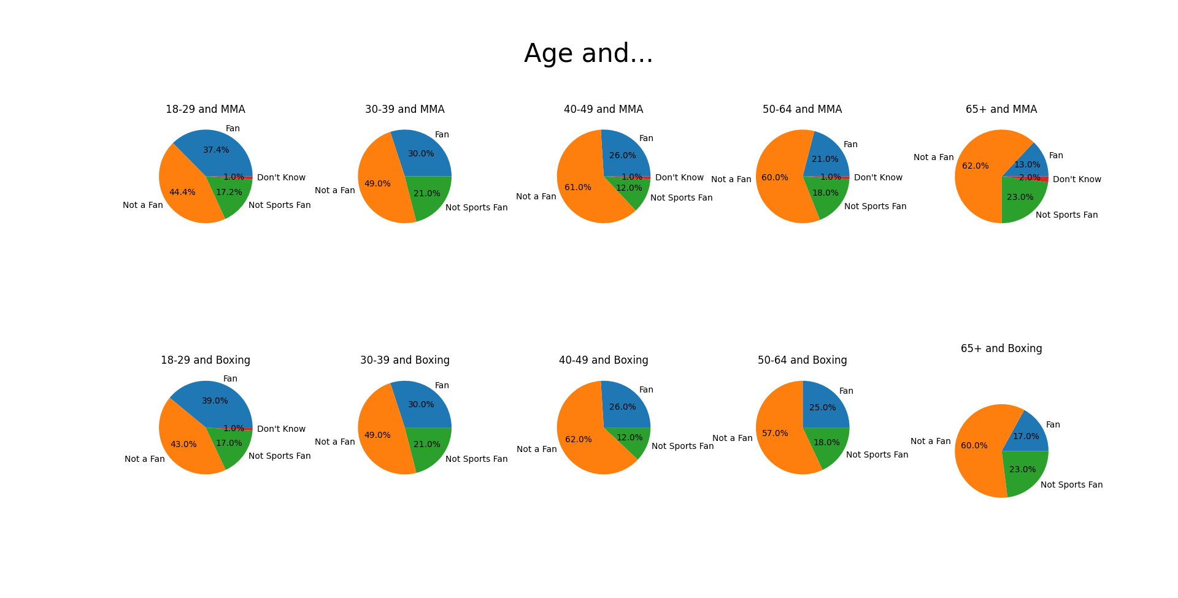

Slide 6

Age and Boxing/MMA
Younger people are more likely to be fans of MMA and Boxing compared to older people. Boxing tends to have more fans than MMA for all age groups, though only by 2-4%.

Slide 7
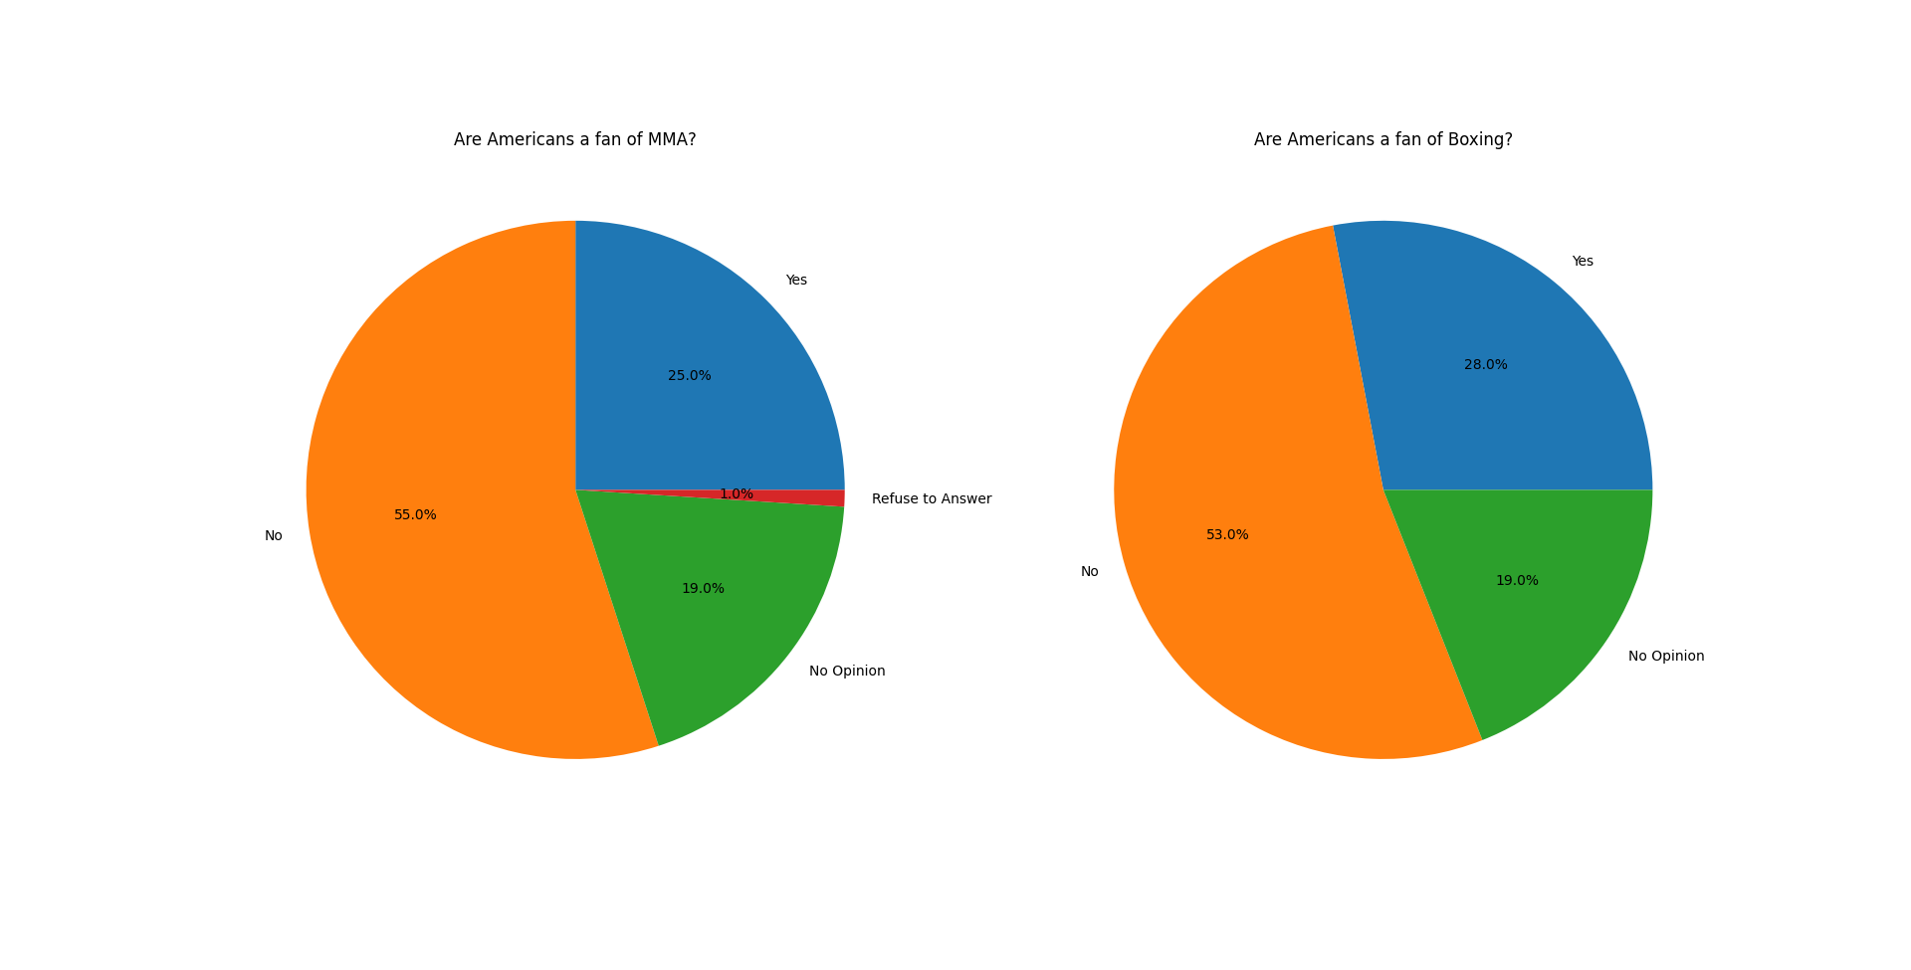
What percentage of people are fans?
28% of Americans are fans of Boxing, while 25% are fans of MMA. This shows an advantage towards Boxing, though only by 3%

Slide 8
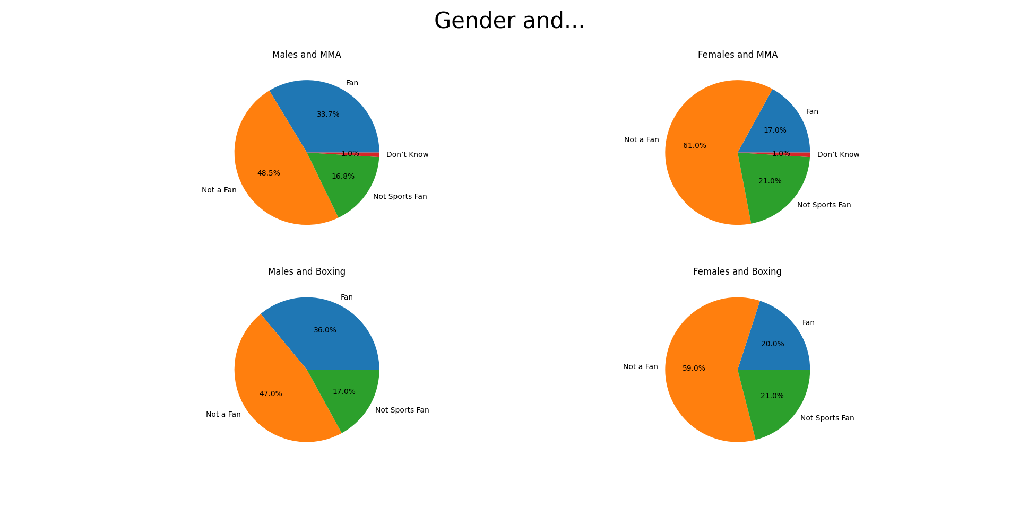


Gender and MMA/Boxing
Males are more likely to be fans of both MMA and Boxing, by over 10%.
Boxing seems to have the advantage in fanship in both genders, at 36% for males and 20% for females, compared to 33.7% of males and 17% of females being fans of MMA.

Slide 9
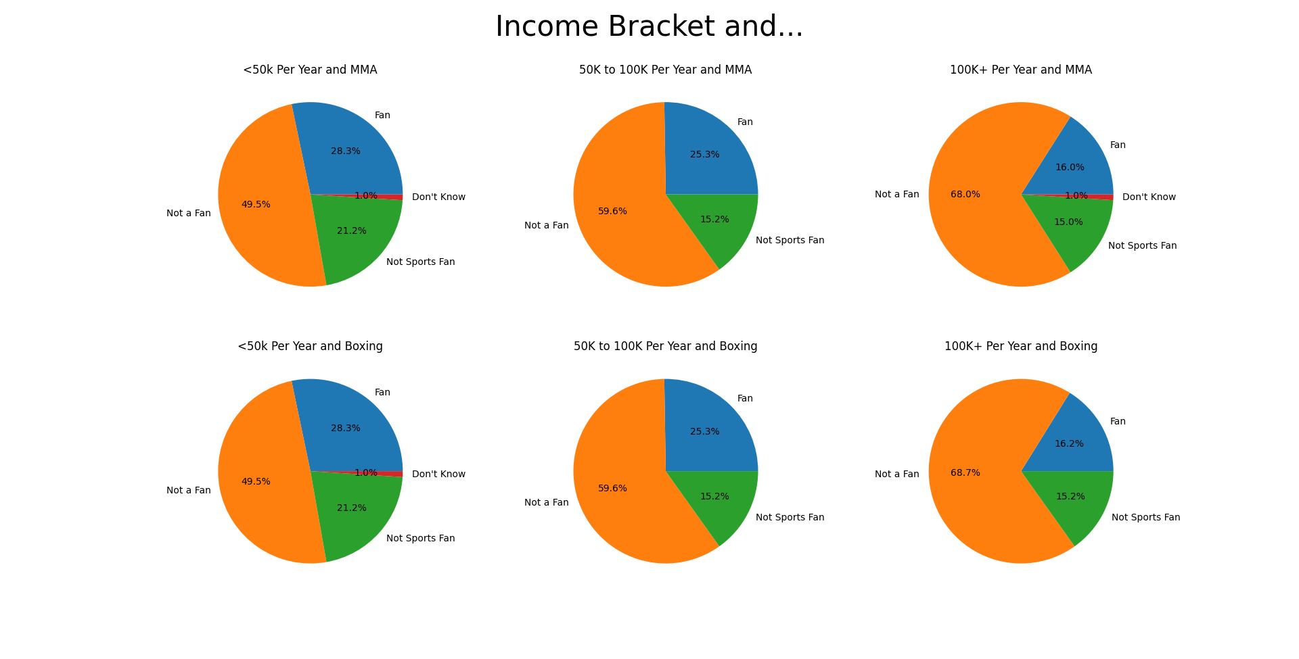


Income and MMA/Boxing
People who earn less are more likely to be fans of both sports, and they have very similar fan percentages for all income brackets (max is +0.2% difference for boxing for people who earn 100k+)
This Photo by Unknown Author is licensed under CC BY-NC
This Photo by Unknown Author is licensed under CC BY-NC

Slide 10
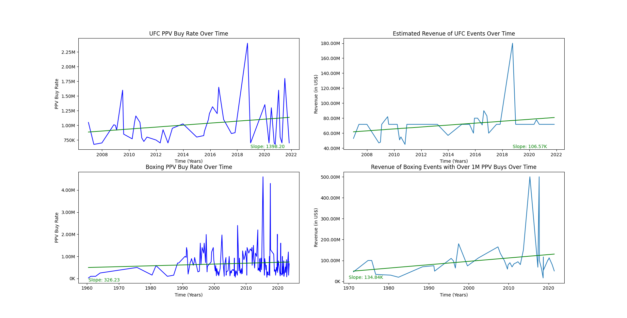
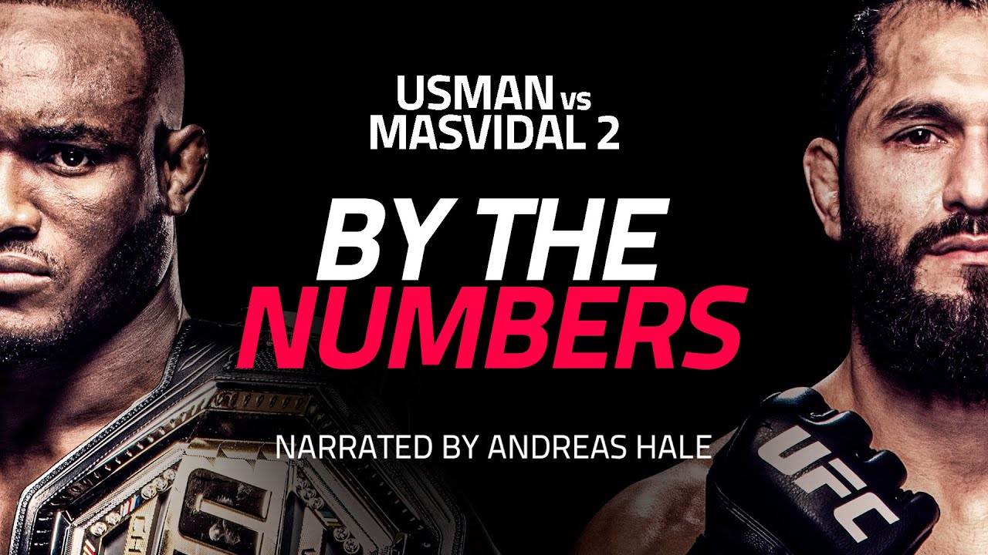
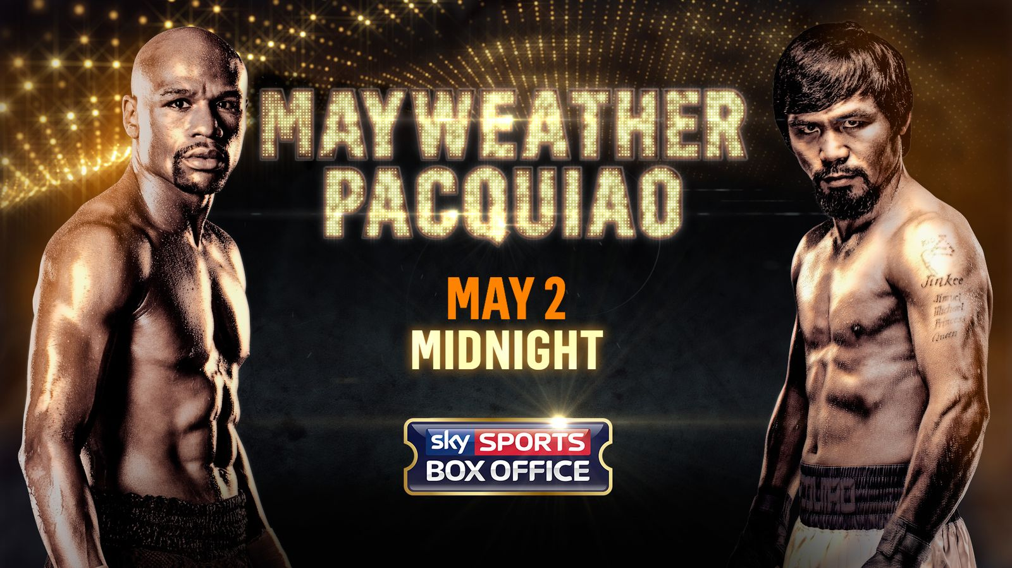
PPV for MMA vs Boxing
Both sports have roughly the same average PPV buys currently, however the UFC (the premier MMA organisation with around 80% of the market) is increasing its PPV sales faster than Boxing.
The UFC is increasing its PPV buys by roughly 1400 PPV buys per month, while boxing is increasing by only 326 PPV buys per month.

Slide 11
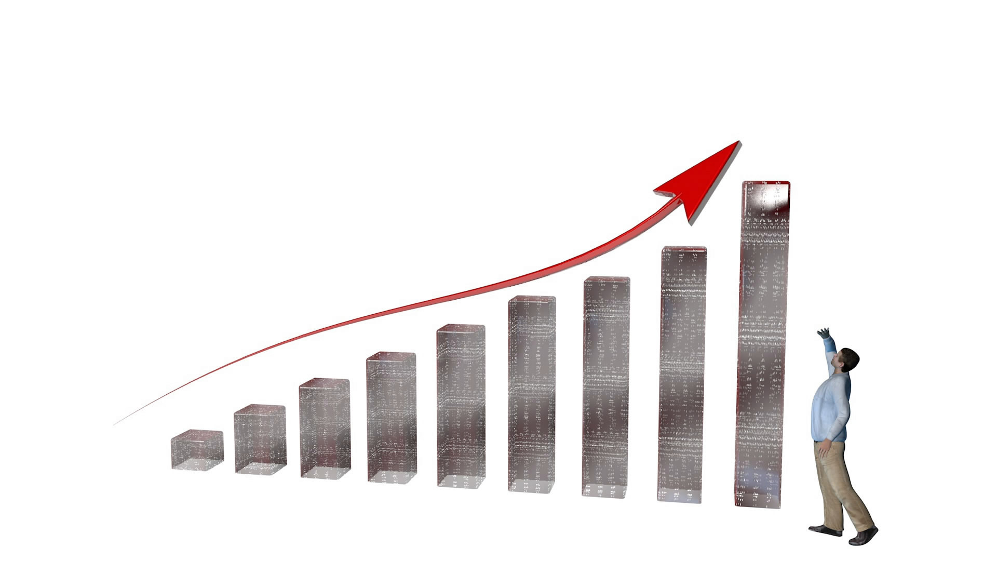

Revenue for MMA vs Boxing
The revenue of UFC events is lower than the revenue for boxing events over 1m PPVs, on average. I could not find any conclusive data on events below 1m PPV buys for boxing, so I had to make do.
Boxing and the UFC are both increasing their revenue by an average of $100k USD per year, with boxing (1m PPV) averaging around $134k and the UFC (all events listed) averaging $107k per year.
Per event, even if the UFC gets less PPV, they do earn more.

Slide 12
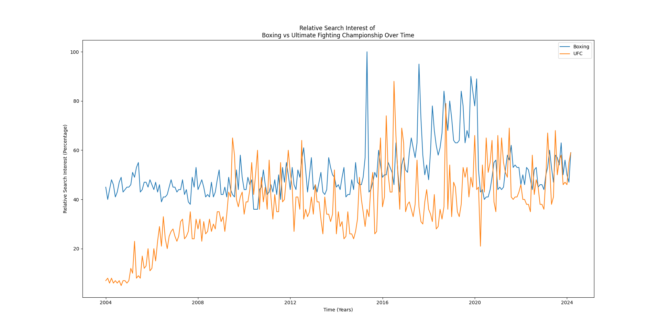

Search Interest and MMA vs Boxing
Both sports have similar relative interest currently, and while boxing’s interest have remained stable, the UFC’s interest have grown rapidly since 2004. This shows an upslope in UFC related content, and an area that would likely benefit from more media.

Slide 13
Direction
Based on the analysis, I believe that both Boxing and MMA are viable options for our media companies.
All age groups, all genders measured, and overall fans are more interested in boxing and with more fans, could mean more profits.
However, revenue, PPV and search interest show that MMA is growing at a faster rate, and to invest early could mean more profit.
Fans like both sports similarly throughout all income brackets

Slide 14
References/Data Resources
Wikipedia (n.d). Pay-per-view [Data Set]. https://en.wikipedia.org/wiki/Pay-per-view [Retrieved 24/03/2024]
Dyck, J.J. (2017). Survey: MMA, boxing reaching new generation of sports fans. https://www.uml.edu/research/public-opinion/polls/2017/mma.aspx
Google (n.d). Ultimate Fighting Championship, Boxing – Explore – Google Trends. https://trends.google.com/trends/explore?date=now%201-d&q=%2Fm%2F016r3g,Boxing&hl=en [Retrieved 24/03/2024]

